Slide 1

2022 SIGKDD Applied Data Science Track Recommendation in Offline Stores: A Gamification Approach for Learning the Spatiotemporal Representation of Indoor Shopping
Jongkyung Shin
Changhun Lee*
Chihyeon Lim*
Ulsan National Institute of Science and Technology (UNIST)
Ulsan, Republic of Korea
Yunmo Shin
Junseok Lim
Retailtech Co., Ltd.
Seoul, Republic of Korea
Notes:
Hello, first of all, thanks to all the presenters for allowing me to be a first presenter.
my name is Jongkyung Shin. I am a Ph.D. student at UNIST / from South Korea.
It is a great honor to present my research at this conference. //
The title of our paper is~

Slide 2
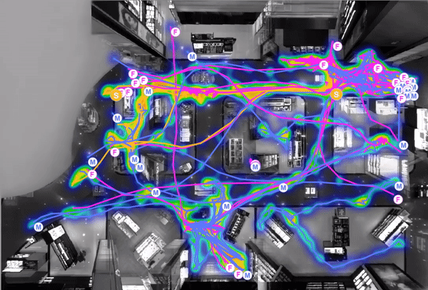
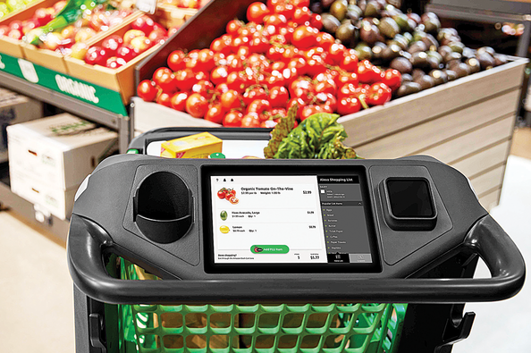
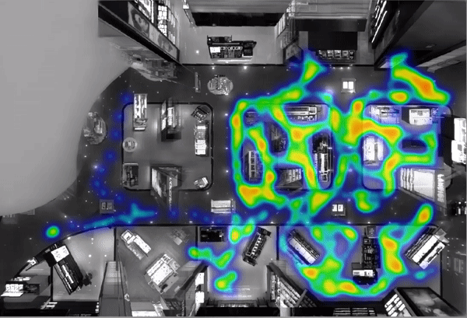
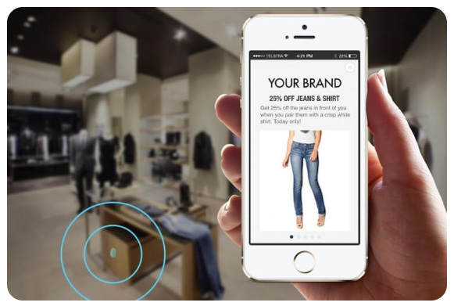
Background : Previous Attempts in Offline Retail
Introduction
1
[1]
[2]
Smart shopping cart
[1]
[3]
Data analytics using cameras (for reduction of congestion)
Location based recommender system using beacon (Bluetooth)
[1] https://www.prodcotech.com/shopper-paths-heatmaps/
[2] https://www.arabnews.com/node/1705276/business-economy
[3] https://www.plotprojects.com/blog/beacon-technology-in-retail-strategies-to-boost-sales/
Notes:
Let me explain the background of our research first.
The offline retailers have attempted to manage their stores and provide new experiences to their customers.
For example, some companies analyzed the customer's movement using cameras to reduce congestion. Also, some stores introduce smart shopping carts and location-based recommender systems using beacon devices.

Slide 3
Main Goal
Introduction
1
Main Goal: Interactive recommender system for offline store
Device
Recsys
[2]
[3]
Customer
Recommendation
Feedback
Smart Shopping Cart
Smart Phone
※ Note: we assume this recommender system is for general customers (not for individual customer). Because many customers in offline stores may utilize smart devices (e.g., smart shopping carts) without logging-in owing to privacy concerns.
Notes:
Taking this background into account, we define the goal of our research to develop interactive recommender system for offline store. Specifically, we focus on two concept, interaction and offline store.
Let me first describe the concept of offline store which has different property compared to online store such as ebay and amarzon. After then, I am going to explain the concept of interactive recommender system.//
For clear understanding, I notice that we assume this recommender system is for general customers not for individual customer

Slide 4
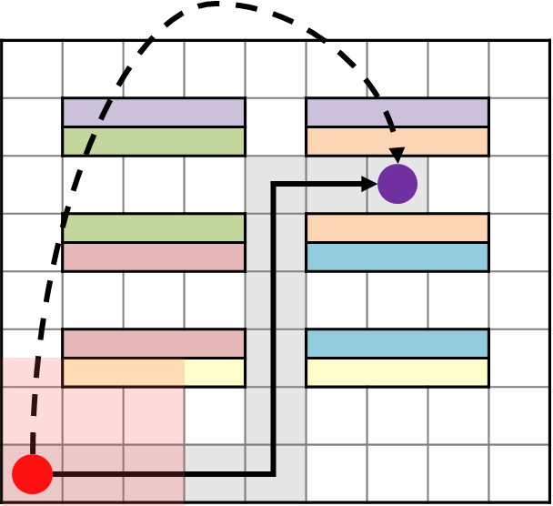
Unique Features of Offline Retail Stores
Introduction
1
Main difference from e-commerce: Physical constraints (e.g., space, structure)
(1) Impossible movement
<Comparison of customer behavior in the offline and online store>
Customer’s behavior | Environment
 | Online store | Offline store
Entrance | Access Homepage/App | Visit a store
Search items | Use search engine | Walk around the store
Confirm recommended items | Watch through the device’s screen | (Watch through the device’s screen)
Adopt recommended items | Click the ‘add on basket’ button | Move toward item and load it
Purchase and pay | Click the ‘payment’ button | Move to counter and payment
(2) Different items are exposed by location
(1) Current location determines where customers can go
(2) Current location determines what customers can see
Customer's spatial condition changes shopping behavior
Context of customers can be continually changed by their location and structure of offline store
Notes:
We analyzed the main difference between online and offline environment is physical constraints.
Unlike online environments, // customers who visit offline stores must move during their shopping.
Because they cannot move desire locations at once.
And these customers are exposed to different items according to their location. Moreover, the exposed items change depending on structure of store.
This suggest that, in offline store, the context of customers can be continually changed by their spatial condition.

Slide 5

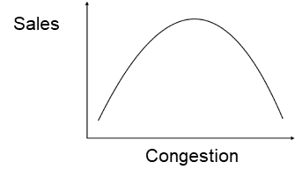
Unique Features of Offline Retail Stores
Introduction
1
Due to the limitation of space
Manage to maximize Sales
Congestion
Sales
Congestion has Inverted U-shaped relationship with sales ^{[4]}
The retailers need to balance the trade-off between the congestion and sales of stores appropriately
[4] Yue Pan and Jennifer Christie Siemens. 2011. The differential effects of retail density: An investigation of goods versus service settings. Journal of Business Research 64, 2 (2011), 105–112
Notes:
Another unique feature of offline store is, retailor need to balance the trade-off between the congestion and sales of stores. It is well known fact that congestion has inverted U-shaped relationship with sales.
For example, if store manage to maximize their sales, then, congestion will increase due to the limitation of the space. Then Increased congestion in the store will make sales decrease.
Therefore, we need to consider this issue to develop interactive recommender system // for offline store.

Slide 6
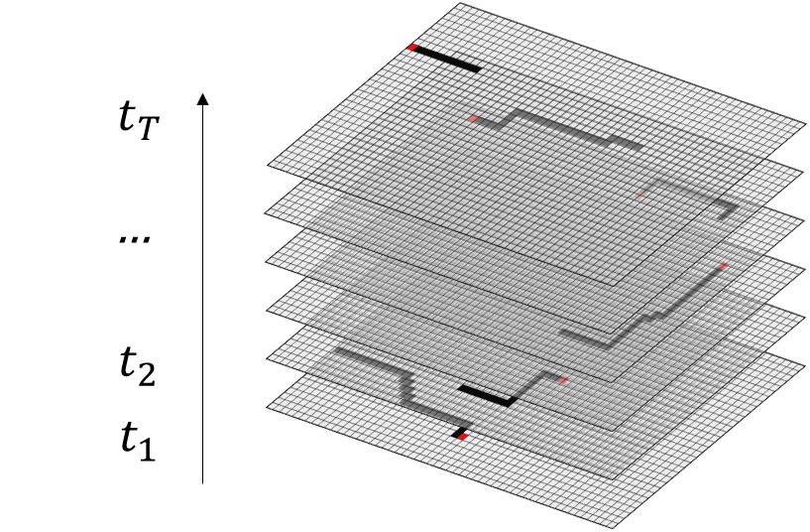
Research Goal & Main Challenge
Introduction
1
Main Goal: Interactive recommender system for offline store
To capture spatiotemporal context of customers
(2) To control sales operation from the perspective of retailer
Main Challenge: Hard to collect data that represent the spatiotemporal context and customer’s feedback
- Devices that can collect customers’ in-store behaviors are available only at a few store
- Installation of new sensors or devices costs a great deal of money
Notes:
So, we attempted to consider two important things. First, we try to make our recommender system understand spatiotemporal context of customer in offline store. Second, we try to let the recommender system to consider the interaction with the customer.
For example, The recommender system drives the customer to return/ specific feedbacks such as/ buying expensive item // for sales maximization //or finishing their shopping for congestion minimization.
However, the data that represents spatio-temporal context and even temporal context are only available at a few stores and expensive to install the device. Therefore, we need to solve the absence of data.

Slide 7
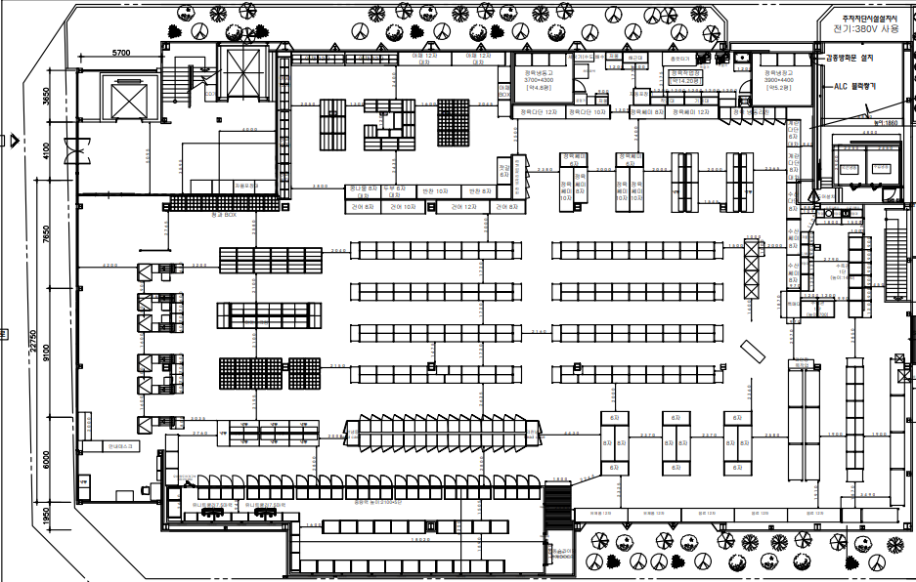
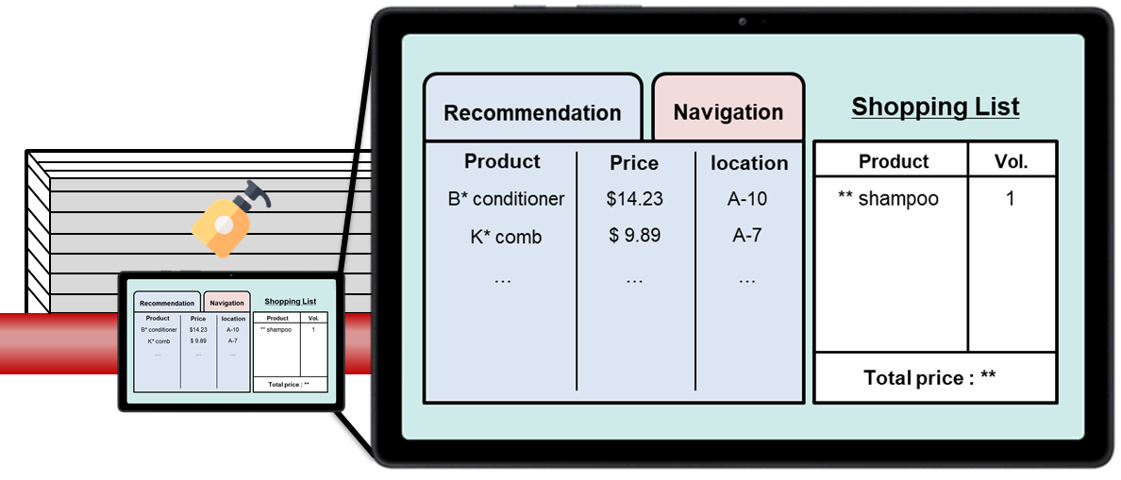
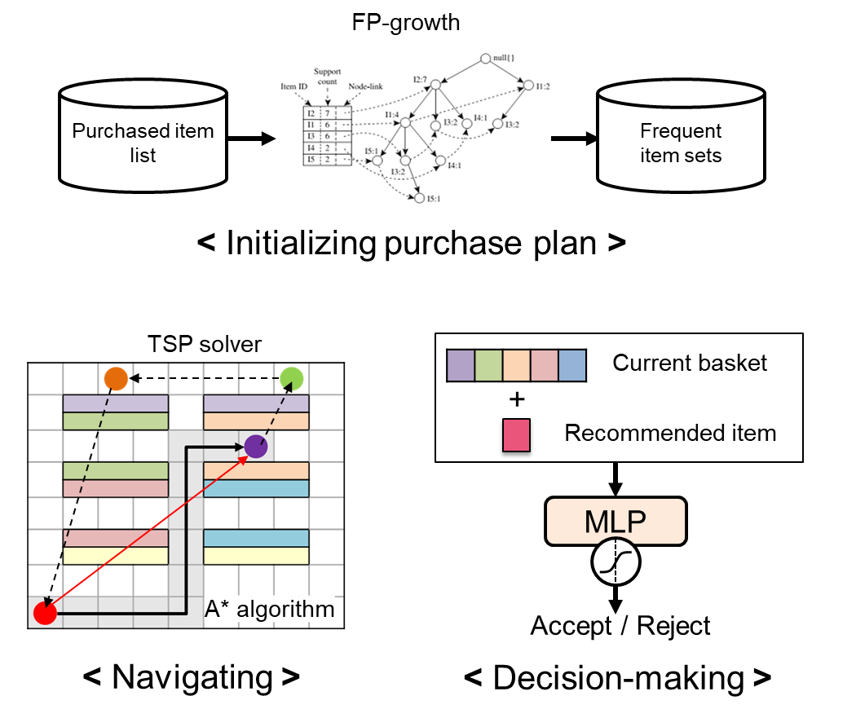
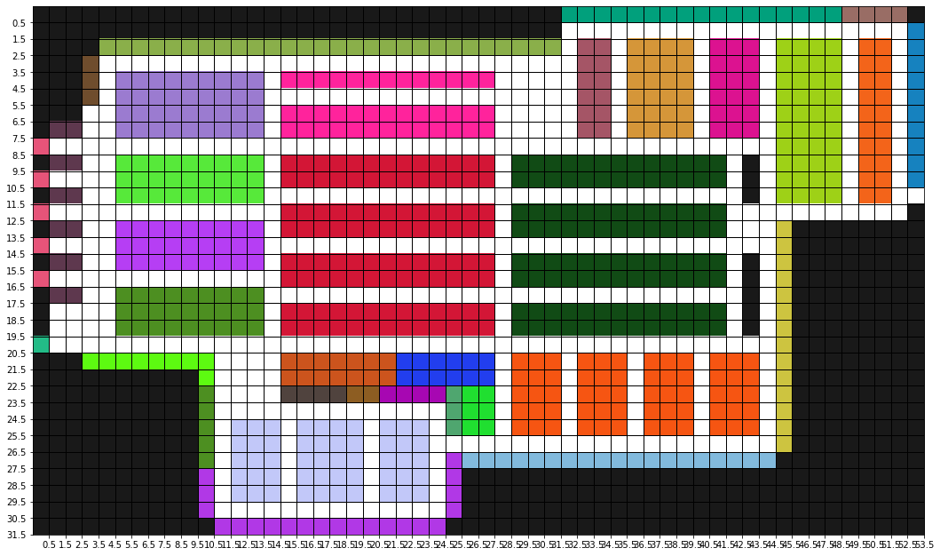
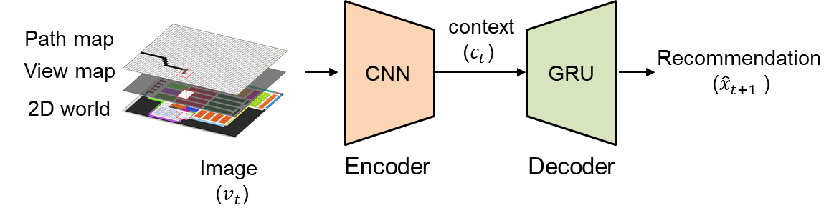
Gamification approach for learning the spatiotemporal representation
Methodology
2
Floor plan and plan-o-gram
Emulate
Recurrent convolutional network (RCN)
Pixel world environment
User model
Recommender system
Notes:
To overcome this challenge, we introduce a gamification approach. There are three components in our approach.
As the first component, we constructed 2D pixel world /that emulates the real space of hypermarket using floor plan and plan-o-gram. Each pixel represents a label such as entrance, counter, aisle and shelf. Here, // each item is assigned to pixel labeled as shelf
The second component is a user model. We built the user model to simulate the general shopping behaviors of customers. We divided shopping behaviors into three parts: purchase planning, navigating and decision-making. In terms of purchase plan, we randomly selected frequent item sets which are extracted by FP-growth algorithm. For navigation, we applied shortest path optimizers such as TSP solver and a-star algorithm. And, the decision-making function was implemented by pre-trained binary classifier.
For the third component, we introduced a recurrent convolutional network, into recommender system to capture spatio-temporal information.
With the images of path map, view map, and 2d pixel world that are overlapped //one after the others, we input this image into the network, //
this RCN network recommend items based on spatio-temporal context.

Slide 8
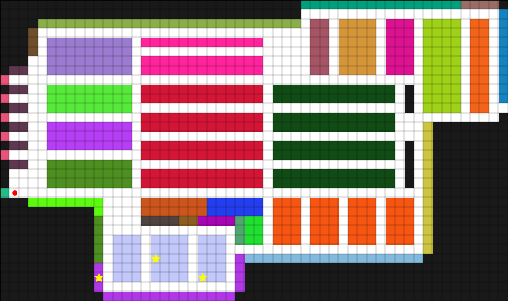
Example of Interactive Training Process
Methodology
2
Red circle : current location of user model
Black circle : user model’s movement
Yellow star : location of an item in the initial purchase plan
Blue star : location of the recommended item that user model accepts
< Recurrent convolutional network (RCN) >
Notes:
As you can see, this video represents the example of interactive training process.
The user model is located at the entrance pixel //and the initialized purchase plan of user model is marked as ‘’yellow star‘’ in this video.
When shopping begins, the user model starts to move to get the items. The red circle ‘here’ represents current location of user model and the black circle represent passing history of user model.
During their shopping, RCN recommender suggest the items to user model, then user model decides whether to accept or reject the item. When user model accepts this recommendation, the user model will go to location of the recommended item and change its optimal path.
The locations of recommended item // that user model accepts // are indicated in blue star. (1,2,3)

Slide 9
Reinforcement Learning for Recommendation and Operations Control
Methodology
2
REINFORCE algorithm
2D-pixel world
Feedback Data storage
Update
Pre-trained RCN (Recsys)
Feedback & Reward
Recommendation
Accept / Reject
Pre-trained User model
Operations Control
To maximize the sales→ Maximize total price of (accepted) recommended items (TPR)
To minimize the congestion in store → Minimize length of shopping (LOS)
Reward function : $R\left({\hat{x}}_{1:T}\right)=\left(1−λ\right)\log{TPR_{scale}\left({\hat{x}}_{1:T}\right)} −λ\log{LOS_{scale}\left({\hat{x}}_{1:T}\right)}$
Notes:
The shopping episodes are generated by interaction between RCN recommender and user model. Using these shopping episode, we update RCN recommender by REINFORCE algorithm to control what Items to recommend.
In terms of sales operation,
we define the reward function that maximize total prices of accepted items and minimize the length of shopping //at the same time.

Slide 10
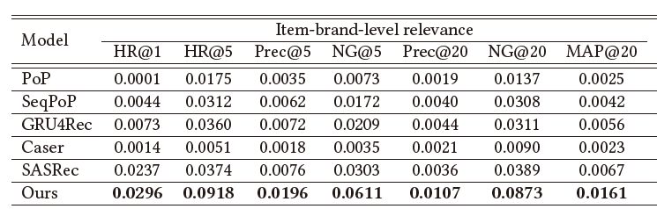
Result of Pre-trained Recurrent Convolutional Network
Experiment
3
Performance comparison between RCN and sequential recommender systems
The model considering spatiotemporal context works more effectively than the models that consider only a temporal context
Notes:
We compared the performance of RCN recommender and the others sequential recommender systems.
Here, the point is that our model considers spatio-temporal context while the baselines only consider temporal information.
As you can see in this table, our model, the RCN recommender, showed the best performance, which proves that// the spatio-temporal context actually works.

Slide 11
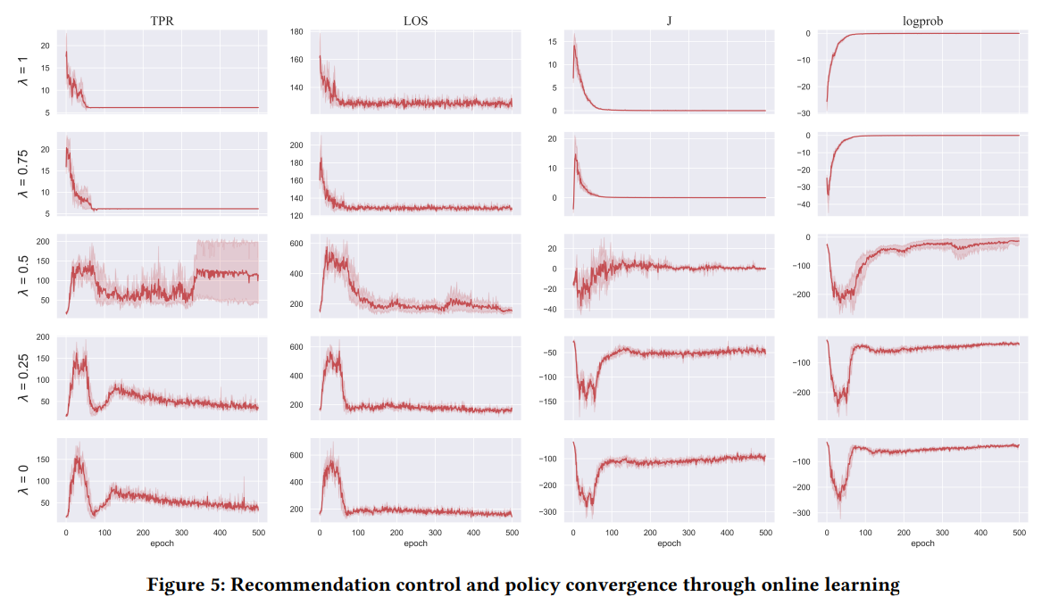
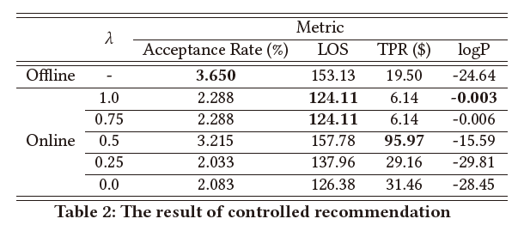
Result of Interactive Training
Experiment
3
Test result of our model trained according to different $λ$ values
LOS control works as expected and TPR is maximized at $λ$ = 0.5
Reward function : $R\left({\hat{x}}_{1:T}\right)=\left(1−λ\right)\log{TPR_{scale}\left({\hat{x}}_{1:T}\right)} −λ\log{LOS_{scale}\left({\hat{x}}_{1:T}\right)}$
Notes:
Also, we conducted ablation study.
Specifically, we changed $λ$ value of reward function and compared the performances.
The result shows that the LOS, the length of shopping, is well controlled as expected /such that the higher lambda value derives the user model/ to accept as less items as possible.
However, the TPR, which denotes /the total price of recommended items, is maximized when $λ$ = 0.5.
This implies that the sales control /depends on the length of shopping because/ the longer time for shopping// the more chance for recommendations.

Slide 12
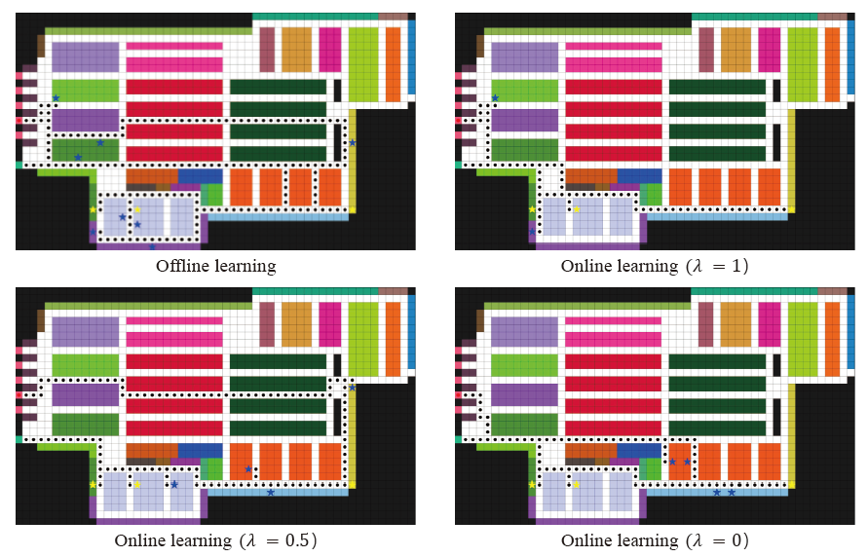
Example of results visualized in the 2D-pixel world
Experiment
3
Only LOS control
LOS & TPR control
Only TPR control
Notes:
This is example of result in the 2D-pixel world according to the lambda value

Slide 13
Conclusion & Future Work
Conclusion
4
Conclusion
We believe that our work will contribute to advancing many location-based services for offline stores, shopping malls, event venues, theme parks, production yards, and other physical environments that can be transformed into virtual environments
The advantage of gamification approach
Do not need any devices that capture the spatiotemporal contexts in training
Can analyze the controllability of recommender system in terms of sales operation under the interactive scenario
Future Work
Solving the existing problem of Recsys: Scalability issue, Personalization
Reflecting the frequently changing sales management
Development of an automatic generation engine that transform the floor plan into the pixel world.
Notes:
In conclusion, we believe that our work will contribute to advancing many location-based services for offline stores, shopping malls and so on.
Specifically, we introduce the concept of gamification. the advantage of gamification approach is that we do not need any devices that capture the spatiotemporal contexts in training step.
In addition, gamification approach allow us to simulate the virtual interaction between user and recommender system .
So that we can analyze the controllability of recommender system //in terms of sales operation under the interactive scenario.
As a future work, we are planning to develop an automatic engine that transform the floor plan into the pixel world. And we also try to solve the existing problem in recommender system.

Slide 14


Thank you
Presenter: Jongkyung Shin
E-mail : shinjk1156@unist.ac.kr
Paper
Github
Notes:
This is end of my presentation. Thank you for your attention.

